Slide 1

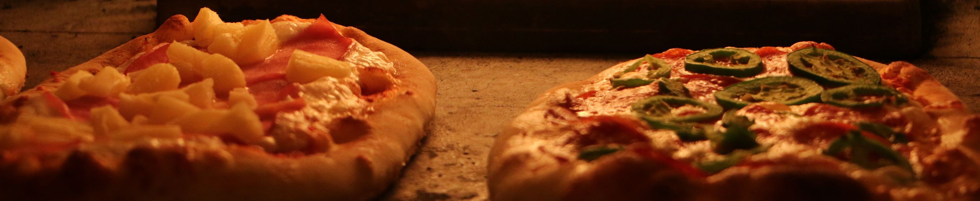
DRIZZLE’S
PIZZAS

Slide 2
ABOUT US
Your Welcome to The Drizzle's Pizza Store! Savor our handcrafted pizzas, made with fresh ingredients and baked to perfection. From classic favorites to unique gourmet creations, every slice is a delight. Enjoy a cozy dine-in experience or fast delivery. Taste the difference at The Drizzle'stext

Slide 3
Hello!
My Name is Jash pawar In this Project I have utilies SQL qurey Related to Pizzas Sales.

Slide 4
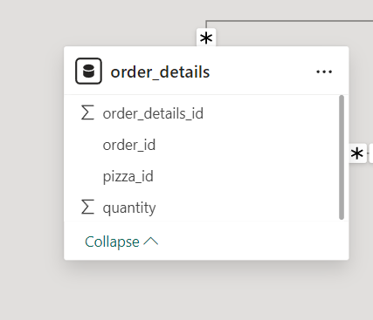
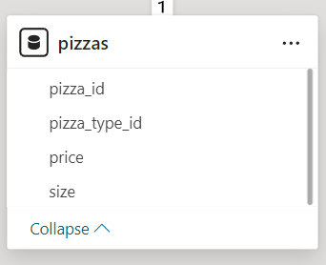
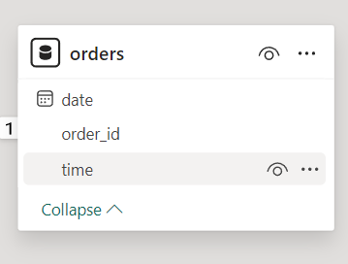
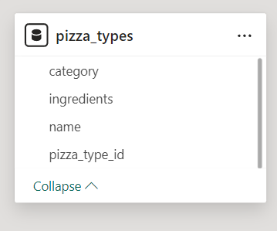

Slide 5
Questions Related to Pizza sales
1. Retrieve the total number of orders placed.
2. Calculate the total revenue generated from pizza sales.
3. Identify the highest-priced pizza.
4. Identify the most common pizza size ordered.
5. List the top 5 most ordered pizza types along with their quantities.
6. Join the necessary tables to find the total quantity of each pizza category ordered.
7. Analyze the cumulative revenue generated over time.
8. Determine the distribution of orders by hour of the day.
9. Determine the top 3 most ordered pizza types based on revenue for each pizza category.

Slide 6
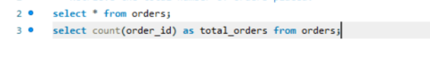
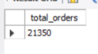
Retrieve the total number of orders placed.

Slide 7
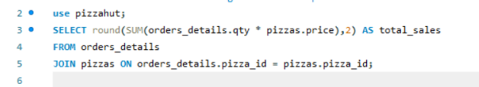
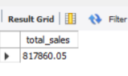
Calculate the total revenue generated from pizza sales.

Slide 8
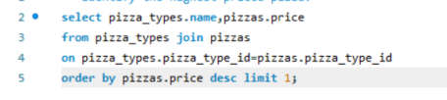
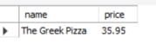
Identify the highest-priced pizza.

Slide 9
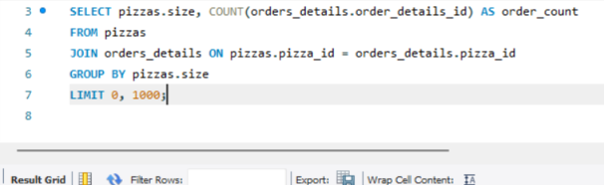
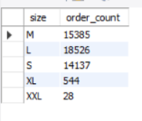
Identify the most common pizza size ordered.

Slide 10
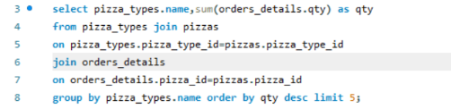
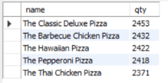
List the top 5 most ordered pizza types along with their quantities.

Slide 11
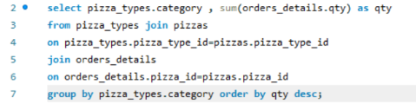
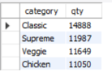
Join the necessary tables to find the total quantity of each pizza category ordered.

Slide 12
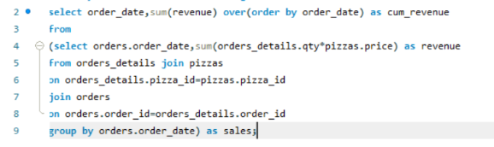
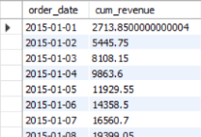
Analyze the cumulative revenue generated over time.

Slide 13
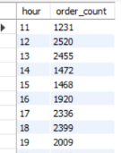
Determine the distribution of orders by hour of the day.

Slide 14
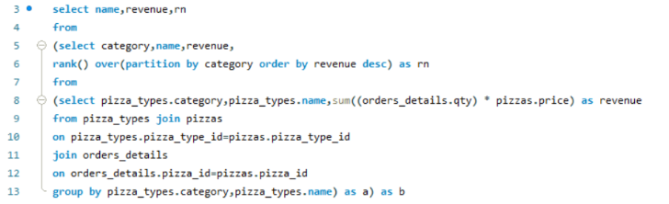
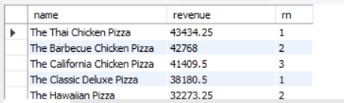
Determine the top 3 most ordered pizza types based on revenue for each pizza category.

Slide 15
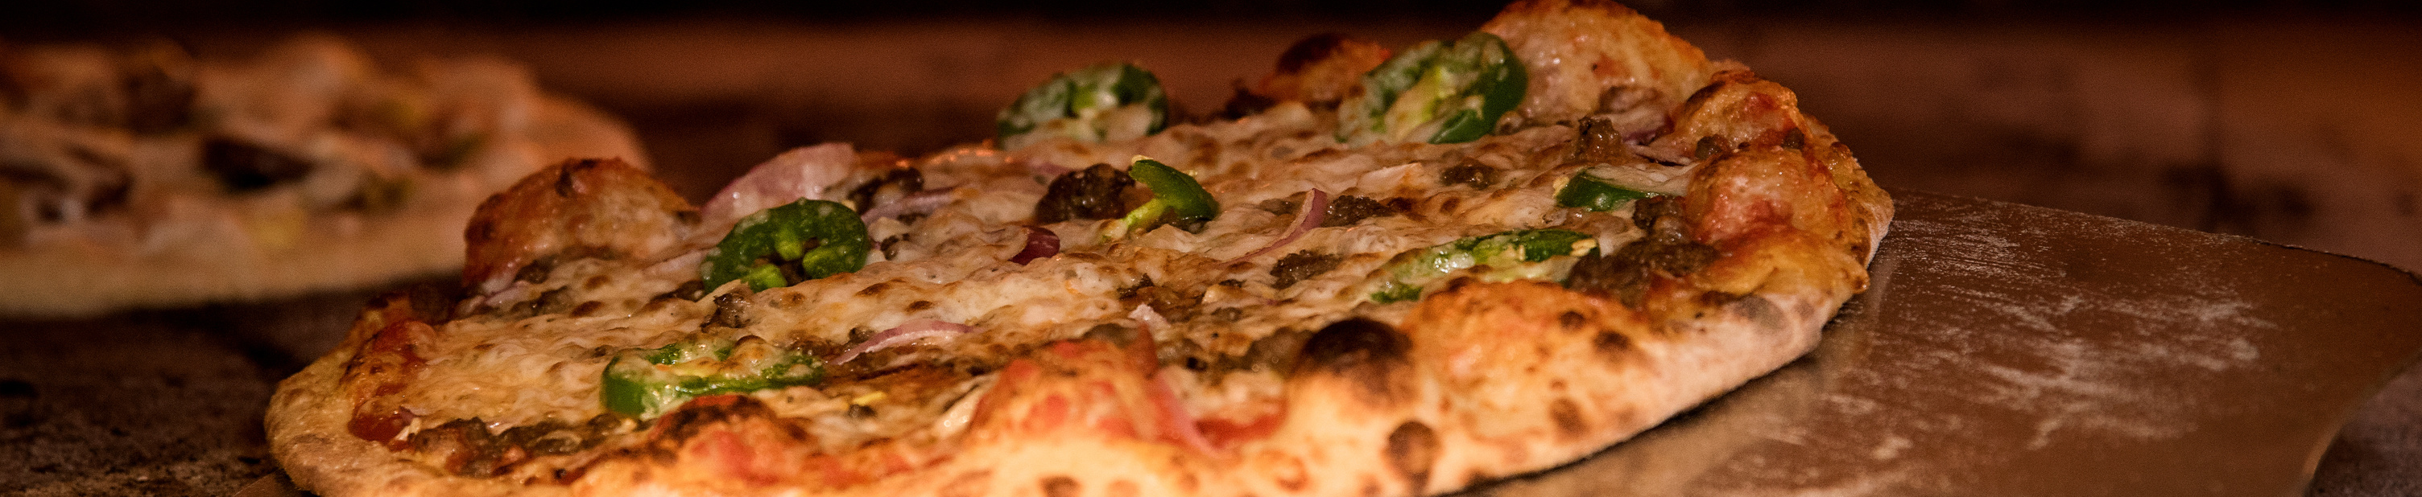
THANK YOU

